Slide 1

Department of Computer Science
Modeling and Simulation
Analysis of Discrete-Time Mortgage Simulation,
Monte Carlo Estimation of Pi, and Single-Server Queue Model
No. | Name | Registration Number
1. | AINEBYONA ALLAN | 2024/A/KCS/1670/F
2. | ARINDA ELIZABETH | 2024/A/KCS/3099/G/F
3. | GUMISIRIZA AMBROSE | 2024/A/KCS/3143/F

Slide 2
1. Overview of the Three Simulation Models
This assignment requires analysis of three provided C simulation codes:
1. Mortgage Payment Simulator
Discrete time stepped model that computes loan balance, interest and principal reduction for each payment period.
2. Monte Carlo Pi Estimator
Stochastic simulation that estimates the mathematical constant π by randomly sampling points inside a unit square.
3. Single Server Queue (ssq1)
Trace-driven discrete-event simulation of a FIFO single-server service node using recorded arrival and service times.

Slide 3
2. Mortgage Model: Description
System / Process Modelled
The code models the repayment of a fixed rate mortgage loan over successive payment periods. It tracks how each payment is split between interest and principal reduction until the loan balance reaches zero.
Key Components
• Inputs: principal amount, annual interest rate, payment size, payment interval (days)
• State variables: current principal balance, accumulated total interest, payment number
• Outputs: per period interest amount, principal reduction, remaining balance, total interest paid
• Assumptions: interest compounds semi-annually according to the bank formula; constant payment size; no early repayment or variable rates; taxes set to zero in the corrected version

Slide 4
3. Mortgage: Type of Simulation & Experiments
Classification: Discrete time (time stepped) deterministic simulation
Time advances in fixed payment intervals (e.g., every 30 days). No random numbers are used; the next state is completely determined by the current balance and the fixed payment and interest factor. The original comments also describe it as “sort of a time-stepped simulation”.
Scenario Analysis (two experiments)
Experiment 1 (Baseline): Principal = $100000, interest = 10.5 %, payment = $1100 every 30 days.
Experiment 2 (Higher payment): Same principal and rate, but payment raised to $1300 every 30 days.
A third run with a smaller payment quickly shows the warning that the payment cannot cover the interest, demonstrating model robustness checks.

Slide 5
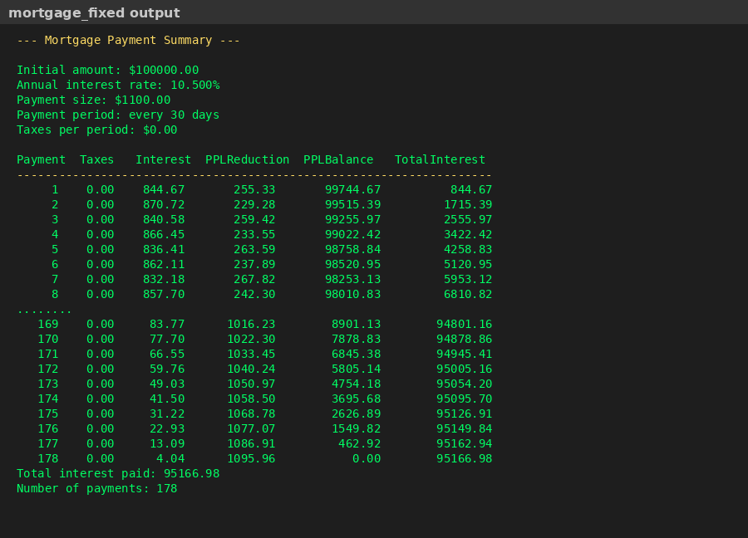
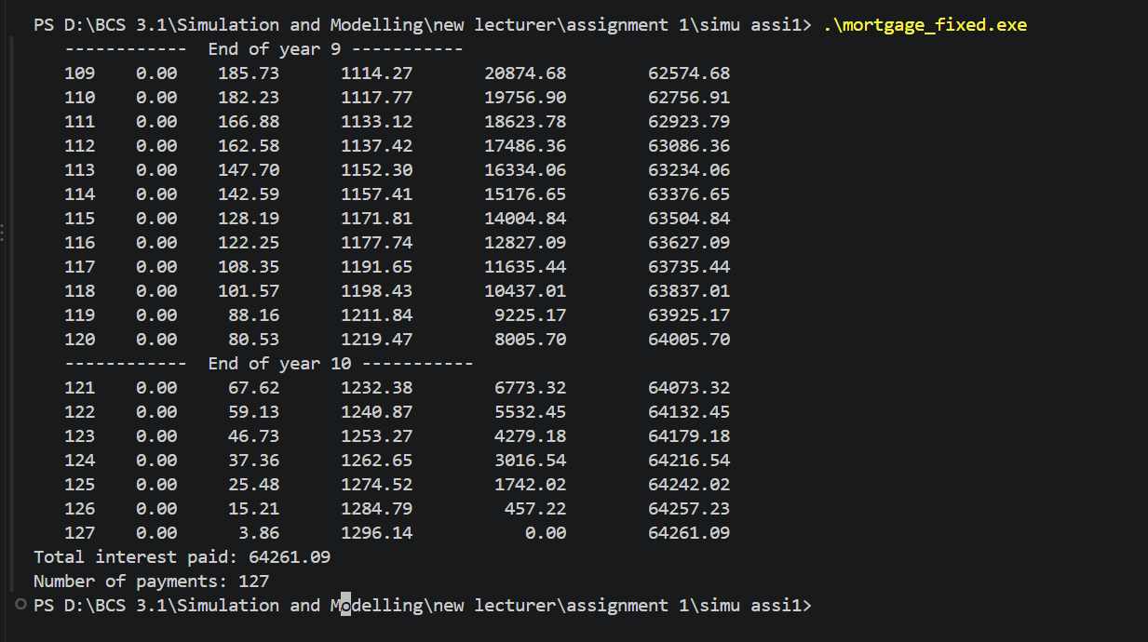
RESULTS
Experiment 2: Fewer payments of 127 and lower total interest($64261.09), showing the effect of accelerated repayment.
Experiment 1: Loan is paid off after 178 payments (≈14.8 years). Total interest paid ≈ $95167.

Slide 6
4. Mortgage: Evaluation, Debugging and Improvements
Identified Limitations / Errors
• Variable ‘taxes’ was declared but never initialised → undefined behaviour (fixed by setting taxes = 0.0).
• No upper bound on the number of iterations → potential infinite loop when payment ≤ interest.
• MONTH_FUDGE alternates 30/31 days, which is only an approximate calendar model.
• Semi-annual compounding formula is hard-coded; real mortgages may use different conventions.
Proposed Improvements
• Add support for variable interest rates and extra payments.
• Use a proper calendar library for exact day counts.
• Output an amortisation schedule to a CSV file for further analysis.
• Allow the user to specify a target loan term and compute the required payment.

Slide 7
5. Monte Carlo Pi Estimator: Model Description
System / Process Modelled
The program estimates the value of π by a classic Monte Carlo geometric probability experiment. Random points are thrown uniformly into the unit square [0,1] × [0,1]. The proportion that fall inside the quarter unit circle is multiplied by 4 to obtain an estimate of π.
Key Components
• Input: number of random trials (iterations)
• State: count of points that satisfy x² + y² ≤ 1
• Output: estimate π̂ = 4 × (count / trials)
• Assumptions: random numbers are independent and uniformly distributed on [0,1]; the geometric probability argument holds exactly in the limit of infinite trials

Slide 8
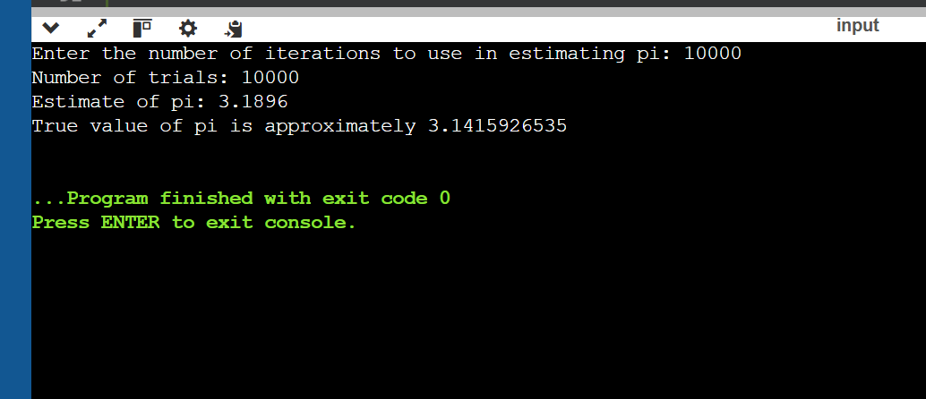
6. Pi Estimator: Type and Simulation Experiments
Classification: Stochastic (Monte Carlo) simulation / static simulation
Justification: Random sampling is the core mechanism. There is no notion of simulated time advancing; each trial is independent. The method relies on the law of large numbers.
Experiment Results (fixed seed 1234567)
Trials | Estimate of π | Absolute Error
100 | 3.1200 | 0.0216
1 000 | 3.2400 | 0.0984
10000 | 3.1896 | 0.0480
100000 | 3.1487 | 0.0071
Observation: accuracy generally improves with more trials, consistent with Monte Carlo theory.

Slide 9
7. Pi Estimator: Evaluation and Code Corrections
Original Code Issues
• Used non-standard POSIX functions srandom() / random() instead of the portable srand() / rand().
• DEBUG macro was permanently set to 1, producing thousands of lines of output for large trial counts.
• Main prototype used an incomplete argument list (char* argv instead of char** argv).
Corrections Applied
• Replaced random-number calls with standard C library functions.
• Disabled verbose DEBUG printing by default.
• Added basic input validation for the number of trials.
• The corrected program produces clean, reproducible estimates.
Further Improvements: use a higher-quality generator (e.g., Mersenne Twister), compute a confidence interval, or parallelise the sampling loop.

Slide 10
8. Single Server Queue (ssq1): Model Description
System / Process Modelled
The program simulates a single-server FIFO service node. Jobs arrive at recorded times, may wait in a queue if the server is busy, receive service, and then depart. The classic performance measures—average inter-arrival time, average service time, average delay in queue and average sojourn (wait) time—are computed.
Key Components (from Leemis’ Discrete-Event Simulation textbook)
• Inputs: trace file of (arrival time, service time) pairs (ssq1.dat)
• State variables: current time of next departure, cumulative sums of delay / wait / service
• Outputs: four average performance statistics for the completed jobs
• Assumptions: server starts idle; infinite queue capacity; FIFO discipline; all jobs are served to completion

Slide 11
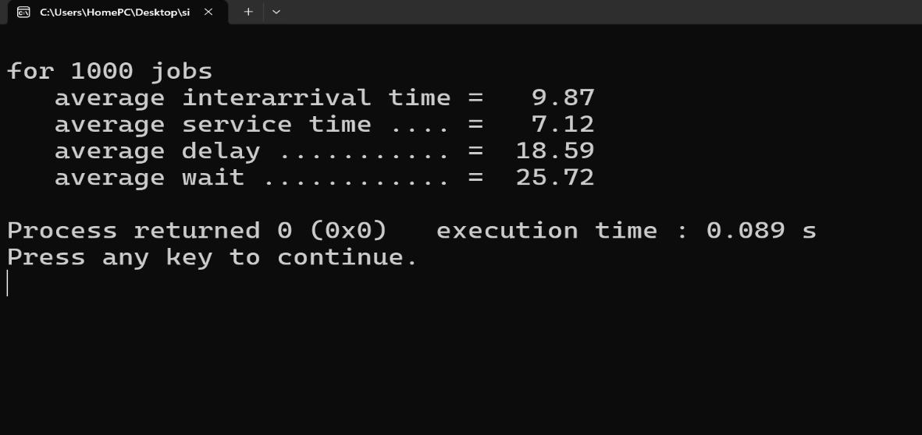
9. SSQ: Type of Simulation and Experiments
Classification: Trace-driven discrete-event simulation
Justification: The simulation advances from one event (arrival or implied departure) to the next. The input data are historical observations rather than random variates generated inside the program. This is the classic “ssq1” example used in teaching discrete-event simulation.
Baseline Results (999–1000 jobs from ssq1.dat)
Statistic | Value
Average inter-arrival time | 9.87
Average service time | 7.12
Average delay in queue | 18.59
Average wait (sojourn) time | 25.72

Slide 12
10. SSQ: Evaluation, Debugging and Improvements
Original Code Issues
• Classic while (!feof(fp)) loop processes one extra (invalid) record after end-of-file.
• Structure initialiser provided only three zeros for a four-field aggregate.
• No check of the return value of fscanf, so a truncated final line could corrupt results.
Corrections Applied
• Replaced the feof test with an explicit check of fscanf success.
• Completed the structure initialiser and introduced a last_arrival variable to compute the correct inter-arrival average.
• The corrected program reports consistent statistics for the supplied data file.
Suggested Extensions: generate random inter-arrival and service times (M/M/1), add multiple servers, compute confidence intervals, or collect time-average queue-length statistics.

Slide 13
11. Conclusions and References
Summary of Findings
The three programs illustrate complementary styles of simulation: deterministic time-stepped (mortgage), pure Monte Carlo (π), and trace-driven discrete-event (single-server queue). Each model required modest debugging before reliable results could be obtained. Scenario experiments confirmed that parameter changes produce the expected qualitative behaviour, reinforcing the teaching goals of the assignment.
References
[1] L. M. Leemis and S. K. Park, Discrete-Event Simulation: A First Course. Pearson, 2006.
[2] A. M. Law, Simulation Modeling and Analysis, 5th ed. McGraw-Hill, 2015.
[3] S. Ross, Simulation, 5th ed. Academic Press, 2013.
[4] “Estimating the value of Pi using Monte Carlo,” GeeksforGeeks, 2017.
Thank you Questions welcome

